Slide 1



Using and contributing to the data.table package for efficient big data analysis
Download these slides: http://ml.nau.edu/latinr.pdf
Toby Dylan Hocking
Assistant Professor
Northern Arizona University
toby.hocking@r-project.org
Funded by NSF POSE program, project #2303612.
Slides adapted from Arun Srinivasan, and datatable-intro vignette - thanks!

Slide 2
who am i?
BA, MS, PHD in Stats/Math (machine learning)
Assistant Professor of computer science since 2018
Using R since 2003! 20 years! Author of 10+ packages
data.table user since 2015, contributor since 2019
Principal Investigator, NSF Pathways to Enable Open-Source Ecosystems (POSE) project, 2023-2025, about data.table

Slide 3
talk overview
What is data.table?
Why is data.table so popular/powerful? (efficiency)
Using data.table for efficient big data analysis
Contributing to data.table
translate documentation from English to another language, get US$500
travel awards: get up to US$2700 to talk about data.table at conferences
participate in community, Issues and Pull Requests on GitHub

Slide 4
1/4
What is data.table?

Slide 5
data.frame in R
DF
2D columnar data structure
rows and columns
subset rows — DF[DF$id != “a”, ]
select columns — DF[, “val”]
subset rows & select columns — DF[DF$id != “a”, “val”]
that’s pretty much it…
 | id | val
1 | b | 4
2 | a | 2
3 | a | 3
4 | c | 1
5 | c | 5
6 | b | 6
 | id | val
1 | b | 4
2 | a | 2
3 | a | 3
4 | c | 1
5 | c | 5
6 | b | 6
 | id | val
1 | b | 4
2 | a | 2
3 | a | 3
4 | c | 1
5 | c | 5
6 | b | 6
 | id | val
1 | b | 4
2 | a | 2
3 | a | 3
4 | c | 1
5 | c | 5
6 | b | 6
 | id | val
1 | b | 4
2 | a | 2
3 | a | 3
4 | c | 1
5 | c | 5
6 | b | 6
 | id | val
1 | b | 4
2 | a | 2
3 | a | 3
4 | c | 1
5 | c | 5
6 | b | 6
2 column data.frame

Slide 6
data.table
DT
Like data.frame, but with more powerful R code syntax, and C code implementation
R package on CRAN since 2006
Created by Matt Dowle, co-author Arun Srinivasan since 2013, 50+ contributors
1463 other CRAN packages require data.table (in most popular 0.05% of all CRAN packages, rank 11/19932 as of 1 Oct 2023)
 | id | val
1 | b | 4
2 | a | 2
3 | a | 3
4 | c | 1
5 | c | 5
6 | b | 6
 | id | val
1 | b | 4
2 | a | 2
3 | a | 3
4 | c | 1
5 | c | 5
6 | b | 6
 | id | val
1 | b | 4
2 | a | 2
3 | a | 3
4 | c | 1
5 | c | 5
6 | b | 6
 | id | val
1 | b | 4
2 | a | 2
3 | a | 3
4 | c | 1
5 | c | 5
6 | b | 6
 | id | val
1 | b | 4
2 | a | 2
3 | a | 3
4 | c | 1
5 | c | 5
6 | b | 6
 | id | val
1 | b | 4
2 | a | 2
3 | a | 3
4 | c | 1
5 | c | 5
6 | b | 6
2 column data.table

Slide 7
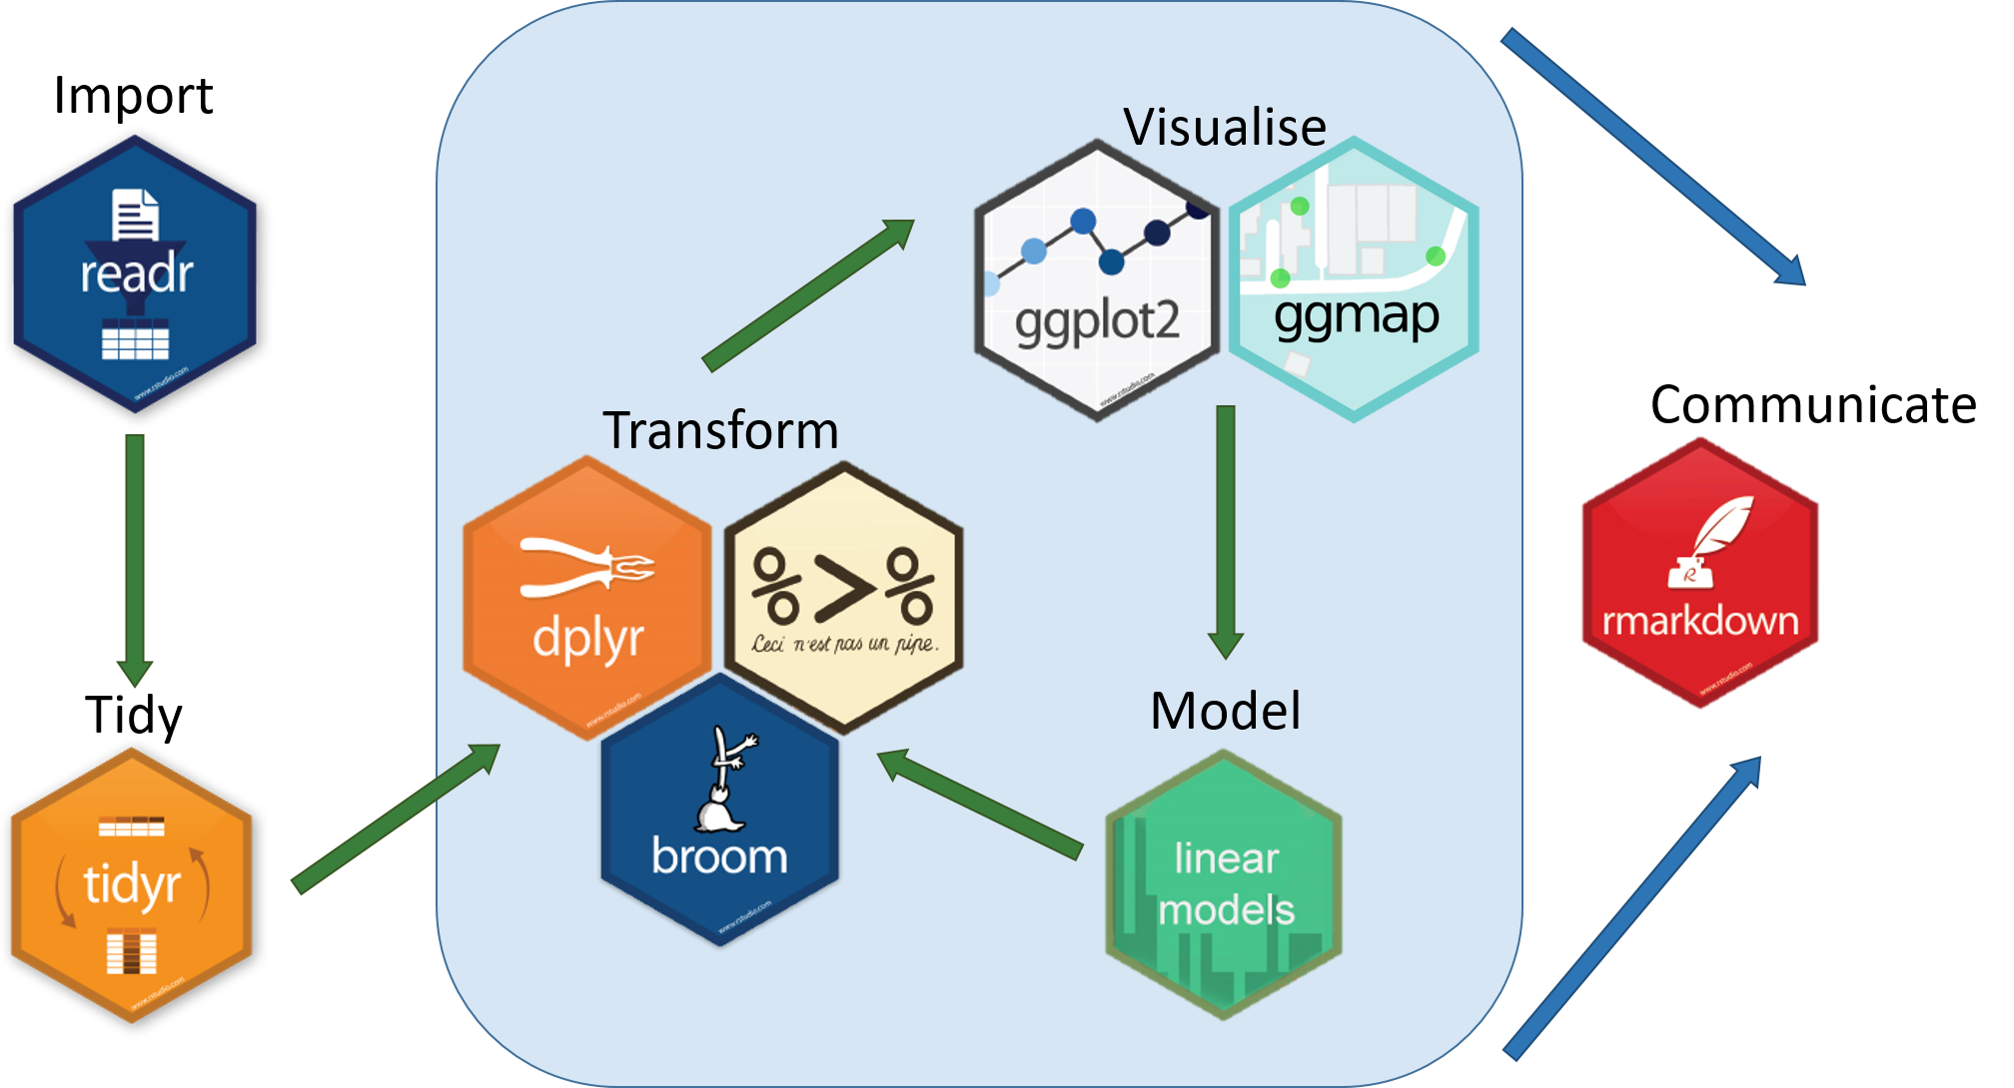
Comparing data.table and tidyverse
tidyverse R package 1.0 on CRAN in 2016
tidyverse packages tibble + readr + tidyr + dplyr ~= data.table
tidyverse uses DF |> ... |>, data.table uses DT[...][...]
tidyverse is verbose (lots of code), data.table is concise (little code) example: tibble |> filter(x=="a") |> group_by(z) |> summarise(m=mean(y)) vs: DT[x=="a", .(m=mean(y)), by=z]
tidyverse has many dependencies, data.table has none (easier to install)
tidyverse has frequent breaking changes, data.table ensures backwards compatibility (easier for users to upgrade to new data.table versions)
https://teachdatascience.com/tidyverse/

Slide 8
2/4
Why is data.table so popular/powerful?
(efficiency)

Slide 9
two kinds of data table efficiency
Efficient R code syntax (saves programming time)
Efficient C code implementation (saves time and memory, so larger data sets can be analyzed using smaller computational resources)

Slide 10

data table R code syntax
think in terms of — rows, what to do with columns, and groups
Matt's 2014 useR talk https://youtu.be/qLrdYhizEMg?t=1m54s
General form: DT[i, j, by]
SQL: WHERE SELECT | UPDATE GROUP BY
Grouped by
what?
On which rows
What to do?

Slide 11
data table R code syntax
are columnar data structures as well
2D — rows and columns
subset rows — DT[id != “a”, ]
select columns — DT[, val]
compute on columns — DT[, mean(val)]
subset rows & select / compute on columns — DT[id != “a”, mean(val)]
virtual 3rd dimension — group by
DT
 | id | val
1: | b | 4
2: | a | 2
3: | a | 3
4: | c | 1
5: | c | 5
6: | b | 6
 | id | val
1: | b | 4
2: | a | 2
3: | a | 3
4: | c | 1
5: | c | 5
6: | b | 6
 | id | val
1: | b | 4
2: | a | 2
3: | a | 3
4: | c | 1
5: | c | 5
6: | b | 6
 | id | val
1: | b | 4
2: | a | 2
3: | a | 3
4: | c | 1
5: | c | 5
6: | b | 6
 | id | val
1: | b | 4
2: | a | 2
3: | a | 3
4: | c | 1
5: | c | 5
6: | b | 6
 | id | val
1: | b | 4
2: | a | 2
3: | a | 3
4: | c | 1
5: | c | 5
6: | b | 6
 | id | val
1: | b | 4
2: | a | 2
3: | a | 3
4: | c | 1
5: | c | 5
6: | b | 6
2 column data.table

Slide 12
data.frame(DF) vs data.table(DT)
sum(DF[DF$code != “abd”, “valA”])
DT[code != “abd”, sum(valA)]
Consider subset of rows with "abd" in code column, then compute sum of values in valA column.
DF needs to be repeated, no repetition of DT.
sum can be placed in the square brackets [ ] with DT, rather than outside with DF.

Slide 13
data.frame(DF) vs data.table(DT)
DF[DF$code == “abd”, “valA”] <- NA
DT[code == “abd”, valA := NA]
For the subset of rows with "abd" in code column, set values in valA column to missing/NA.
Need to repeat DF, no need to repeat DT.
DF uses arrow assignment <- DT uses walrus :=

Slide 14
data.frame(DF) vs data.table(DT)
aggregate(cbind(valA, valB) ~ id,
DF[DF$code != “abd”, ],
sum)
DT[code != “abd”,
.(sum(valA), sum(valB)),
by = id]
Summarize by group: consider subset of rows with "abd" in code column, then compute sum of values in valA and valB columns, for each unique value of the id column.
Everything under DT square brackets [ ], whereas using DF we need to use other functions (aggregate, cbind)

Slide 15
data.frame(DF) vs data.table(DT)
DF1 <- merge(DF1, DF2, all.x=TRUE)
DF1[, “valA”] <- ifelse(is.na(DF1$val),
DF1$valA, DF1$val)
DF1$val <- NULL
DT1[DT2, valA := val, on = .(id, code)]
Modify while joining: for every row of DT1 which matches a row of DT2 on id and code columns, set valA to val
Easy to do with DT, := assignment, and on= argument
Difficult but possible to do in base R with DF

Slide 16
two kinds of data table efficiency
Efficient R code syntax (saves programming time)
Efficient C code implementation (saves time and memory, so larger data sets can be analyzed using smaller computational resources)

Slide 17
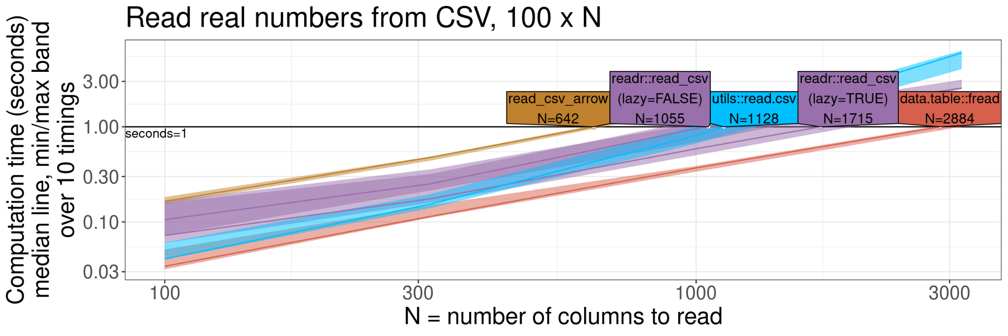
data.table::fread is an extremely efficient CSV file reader
100
3000
100
100
Source code: https://tdhock.github.io/blog/2023/dt-atime-figures/

Slide 18
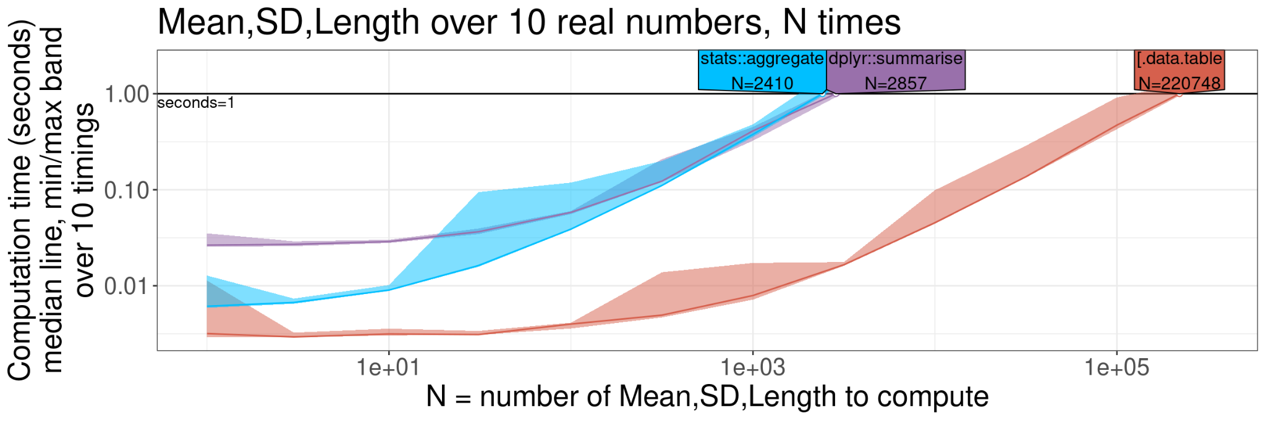
data.table computes summaries 100x faster than others
loss
fold
epoch
epoch
Mean
SD
Length
1
...
N
1
...
1
In machine learning, K-fold cross-validation is used to estimate the loss of a hyper-parameter, such as the number of epochs of training of a neural network.
data.table can efficiently compute the average loss over the K=10 folds, for each of the N epochs.
...
1
...
N
1
...
N
10
...
10

Slide 19
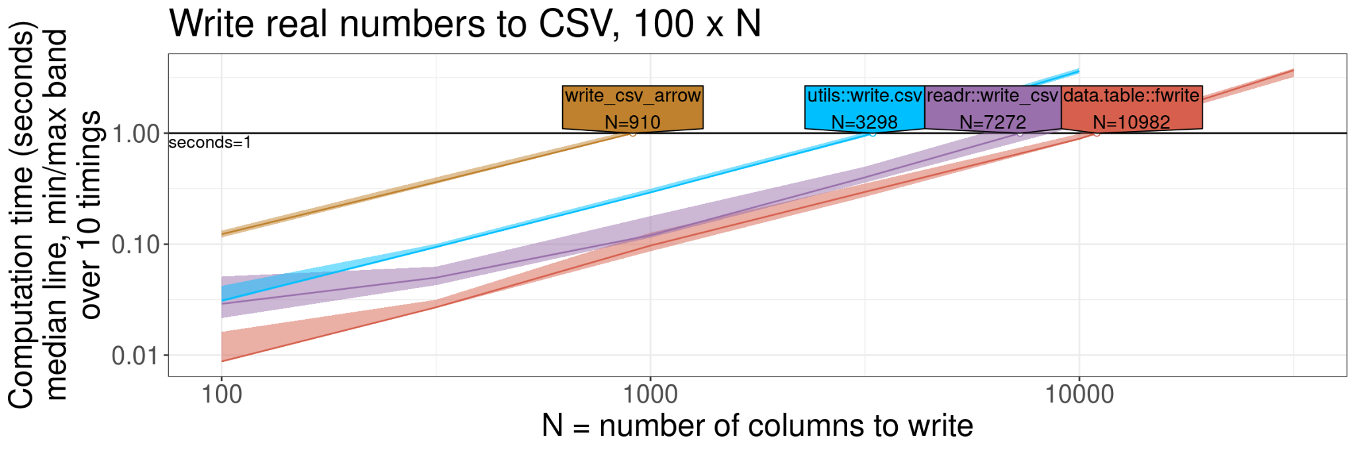
data.table::fwrite is an extremely efficient CSV file writer
100
10000
100
100
Source code: https://tdhock.github.io/blog/2023/dt-atime-figures/

Slide 20
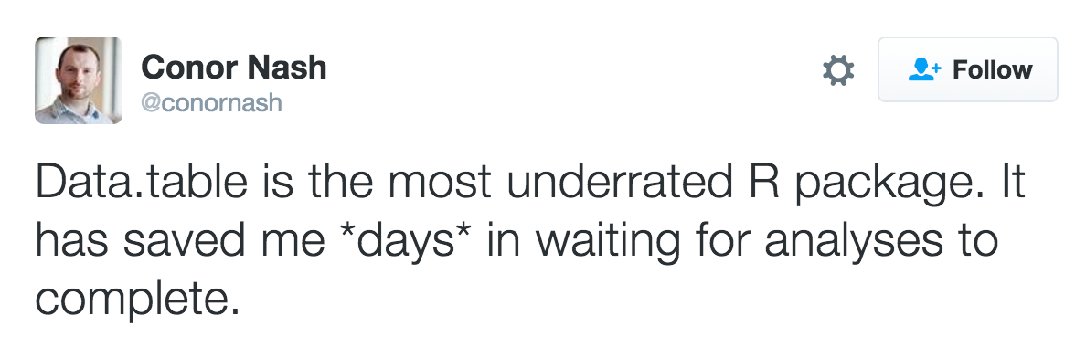
most underrated package

Slide 21
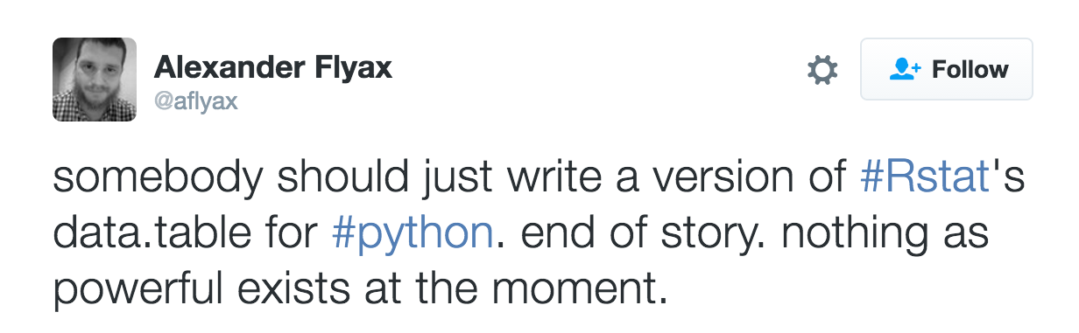
powerful

Slide 22
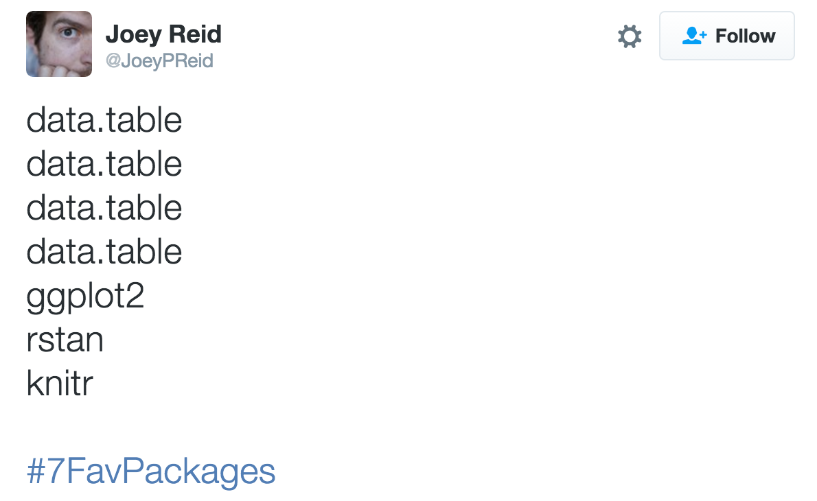
data.table data.table data.table

Slide 23
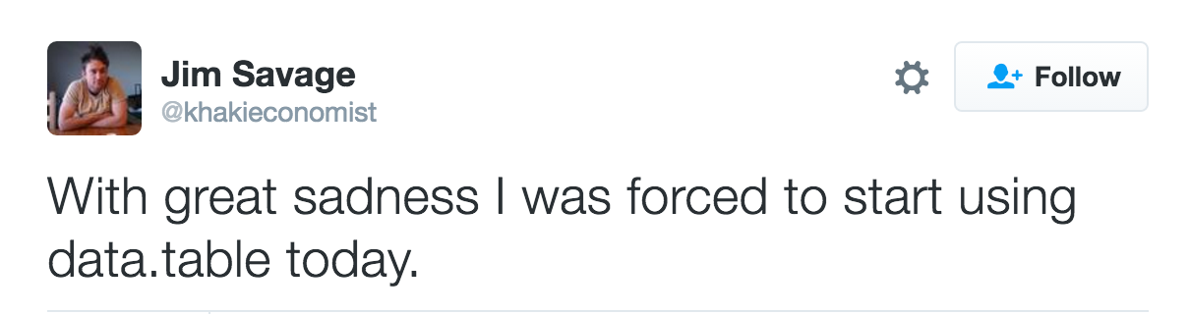
great sadness

Slide 24
3/4
Using data.table for efficient big data analysis

Slide 25
Install data.table, get PDF docs
Exercise: install development version from GitHub, which contains the most recent new features
Download cheat sheet http://ml.nau.edu/dtcheat.pdf
Getting started in R - tinyverse edition http://ml.nau.edu/tiny.pdf
> install.packages("remotes")
> remotes::install_github("Rdatatable/data.table")
(need a compiler: xcode for mac, or rtools for windows)
OR: if you do not have a compiler: install from CRAN then update:
> install.packages("data.table")
> data.table::update_dev_pkg()

Slide 26
Create data.table from R objects
data.table(column_name=column_value), just like data.frame
values in short columns recycled to length of largest column
> data.table(
+ ID = c("b","b","b","a","a","c"),
+ a = 1:2,
+ b = 7,
+ c = 13:18
+ )
ID a b c
1: b 1 7 13
2: b 2 7 14
3: b 1 7 15
4: a 2 7 16
5: a 1 7 17
6: c 2 7 18

Slide 27
data.table vs frame columns
non-syntactic variable names are kept by default
> head(data.table("10^8 m^3"=Nile, year=1871:1970))
10^8 m^3 year
1: 1120 1871
2: 1160 1872
3: 963 1873
4: 1210 1874
5: 1160 1875
6: 1160 1876
> head(data.frame("10^8 m^3"=Nile, year=1871:1970))
X10.8.m.3 year
1 1120 1871
2 1160 1872
3 963 1873
4 1210 1874
5 1160 1875
6 1160 1876

Slide 28
data.table vs frame list columns
need to use I( ) to create list columns in frame, not table
> data.table(L=list("scalar", c("vec","tor")),x=1:2)
L x
1: scalar 1
2: vec,tor 2
> data.frame(L=I(list("scalar", c("vec","tor"))),x=1:2)
L x
1 scalar 1
2 vec, tor 2

Slide 29
Exercises
Your turn: convert the built-in iris data set to a data table via data.table(iris)
Create data table with one row, and columns for your name (character), years experience with R (numeric), birthplace (character), city of residence (character), language(s) spoken (list of character)

Slide 30
Read CSV from file
Airline NYC-flights14 data set
> if(!file.exists("flights14.csv"))download.file(
+ "http://ml.nau.edu/flights14.csv",
+ "flights14.csv")
> (flights <- data.table::fread("flights14.csv"))
year month day dep_delay arr_delay carrier origin dest air_time distance hour
1: 2014 1 1 14 13 AA JFK LAX 359 2475 9
2: 2014 1 1 -3 13 AA JFK LAX 363 2475 11
3: 2014 1 1 2 9 AA JFK LAX 351 2475 19
4: 2014 1 1 -8 -26 AA LGA PBI 157 1035 7
5: 2014 1 1 2 1 AA JFK LAX 350 2475 13
---
253312: 2014 10 31 1 -30 UA LGA IAH 201 1416 14
253313: 2014 10 31 -5 -14 UA EWR IAH 189 1400 8
253314: 2014 10 31 -8 16 MQ LGA RDU 83 431 11
253315: 2014 10 31 -4 15 MQ LGA DTW 75 502 11
253316: 2014 10 31 -5 1 MQ LGA SDF 110 659 8

Slide 31
Read CSV from shell command
Useful with commands that output CSV data (no intermediate file)
egrep useful if you do not need/want to read full data set into R
> data.table::fread("egrep 'LAX|year' flights14.csv")
year month day dep_delay arr_delay carrier origin dest air_time distance hour
1: 2014 1 1 14 13 AA JFK LAX 359 2475 9
2: 2014 1 1 -3 13 AA JFK LAX 363 2475 11
3: 2014 1 1 2 9 AA JFK LAX 351 2475 19
4: 2014 1 1 2 1 AA JFK LAX 350 2475 13
5: 2014 1 1 4 0 AA EWR LAX 339 2454 18
---
14430: 2014 10 31 -6 -38 UA JFK LAX 323 2475 11
14431: 2014 10 31 9 -21 UA EWR LAX 323 2454 13
14432: 2014 10 31 40 14 UA EWR LAX 320 2454 18
14433: 2014 10 31 3 -32 UA EWR LAX 320 2454 20
14434: 2014 10 31 10 -27 UA EWR LAX 326 2454 10

Slide 32
Exercise: Read CSV from URL
Convenient, but I usually download.file( ) first, to avoid having to download the file again, after re-starting R
Your turn, try the following code:
flights <- data.table::fread("http://ml.nau.edu/flights14.csv")

Slide 33
Subset rows using i
think in terms of basic units — rows, columns and groups
data.table syntax provides placeholder for each of them
General form: DT[i, j, by]
Grouped by
what?
On which rows
What to do?

Slide 34
Logical row subset
Get all the flights with "JFK" as the origin airport in the month of June.
DT[rows, ] comma not necessary (but allowed)
> flights[origin == "JFK" & month == 6]
year month day dep_delay arr_delay carrier origin dest air_time distance hour
1: 2014 6 1 -9 -5 AA JFK LAX 324 2475 8
2: 2014 6 1 -10 -13 AA JFK LAX 329 2475 12
3: 2014 6 1 18 -1 AA JFK LAX 326 2475 7
4: 2014 6 1 -6 -16 AA JFK LAX 320 2475 10
5: 2014 6 1 -4 -45 AA JFK LAX 326 2475 18
---
8418: 2014 6 30 -3 -6 MQ JFK PIT 62 340 14
8419: 2014 6 30 -5 -32 MQ JFK RDU 65 427 14
8420: 2014 6 30 -3 -16 MQ JFK DCA 39 213 17
8421: 2014 6 30 -2 7 MQ JFK DCA 52 213 7
8422: 2014 6 30 -7 -18 MQ JFK RDU 67 427 8

Slide 35
Integer row subset
Get the first two flights, or all except the first two.
Integer subset in DT works just like in DF.
> flights[1:2]
year month day dep_delay arr_delay carrier origin dest air_time distance hour
1: 2014 1 1 14 13 AA JFK LAX 359 2475 9
2: 2014 1 1 -3 13 AA JFK LAX 363 2475 11
> flights[-(1:2)]
year month day dep_delay arr_delay carrier origin dest air_time distance hour
1: 2014 1 1 2 9 AA JFK LAX 351 2475 19
2: 2014 1 1 -8 -26 AA LGA PBI 157 1035 7
3: 2014 1 1 2 1 AA JFK LAX 350 2475 13
4: 2014 1 1 4 0 AA EWR LAX 339 2454 18
5: 2014 1 1 -2 -18 AA JFK LAX 338 2475 21
---
253310: 2014 10 31 1 -30 UA LGA IAH 201 1416 14
253311: 2014 10 31 -5 -14 UA EWR IAH 189 1400 8
253312: 2014 10 31 -8 16 MQ LGA RDU 83 431 11
253313: 2014 10 31 -4 15 MQ LGA DTW 75 502 11
253314: 2014 10 31 -5 1 MQ LGA SDF 110 659 8

Slide 36
Sort rows
Sort flights first by column origin in ascending order, and then by dest in descending order
data.table sort is so efficient that it was integrated into base R in 2016!
> flights[order(origin, -dest)]
year month day dep_delay arr_delay carrier origin dest air_time distance hour
1: 2014 1 5 6 49 EV EWR XNA 195 1131 8
2: 2014 1 6 7 13 EV EWR XNA 190 1131 8
3: 2014 1 7 -6 -13 EV EWR XNA 179 1131 8
4: 2014 1 8 -7 -12 EV EWR XNA 184 1131 8
5: 2014 1 9 16 7 EV EWR XNA 181 1131 8
---
253312: 2014 10 31 -1 -22 WN LGA ATL 112 762 9
253313: 2014 10 31 -5 -23 WN LGA ATL 112 762 20
253314: 2014 4 6 -6 -1 EV LGA AGS 110 678 10
253315: 2014 4 7 2 1 EV LGA AGS 111 678 11
253316: 2014 4 11 0 -19 EV LGA AGS 102 678 10

Slide 37
Exercises
Your turn, how many rows are there with carrier "AA" and dest "LAX" ?
If you sort that table, what is the first and last month/day/hour?
Hint: You can use DT[ ... ][ ... ] in a chain. Similar to piping, DF |> ... |> ...

Slide 38
Compute columns in j
think in terms of basic units — rows, columns and groups
data.table syntax provides placeholder for each of them
General form: DT[i, j, by]
Grouped by
what?
On which rows
What to do?

Slide 39
Select one column
DT[, "arr_delay"] -> data.table with one column
DT[, arr_delay] -> vector like DT$arr_delay or DT[["arr_delay"]] in base R
Exercise: use hist( ) to plot a histogram of departure delays
> str(flights[, "arr_delay" ])
Classes ‘data.table’ and 'data.frame': 253316 obs. of 1 variable:
$ arr_delay: int 13 13 9 -26 1 0 -18 -14 -17 -14 ...
- attr(*, ".internal.selfref")=<externalptr>
> str(flights[, arr_delay]) #like DT[["arr_delay"]] or DT$arr_delay
int [1:253316] 13 13 9 -26 1 0 -18 -14 -17 -14 ...

Slide 40
Select two columns with literal
If data.table/list/. is used in j, then a data.table is returned
Can also use c("name") in j
> flights[, data.table(arr_delay, dep_delay)]
arr_delay dep_delay
1: 13 14
2: 13 -3
---
253315: 15 -4
253316: 1 -5
> flights[, c("arr_delay", "dep_delay")]
arr_delay dep_delay
1: 13 14
2: 13 -3
---
253315: 15 -4
253316: 1 -5

Slide 41
Select two columns with variable
Can use with=FALSE or double dot notation .. (like one level up in unix file path, look for select_cols in environment, not as a column name)
> (DT=data.table(x=1:2, y=3:4,
select_cols=c("foo", "bar")))
x y select_cols
1: 1 3 foo
2: 2 4 bar
> select_cols=c("x","y")
> DT[, select_cols]
[1] "foo" "bar"
> DT[, ..select_cols]
x y
1: 1 3
2: 2 4
> DT[, select_cols, with=FALSE]
x y
1: 1 3
2: 2 4

Slide 42
Select all columns except two
Can use either ! or - to negate the selection of columns
> delay_cols = c("arr_delay", "dep_delay")
> head(flights[, !..delay_cols])
year month day carrier origin dest air_time distance hour
1: 2014 1 1 AA JFK LAX 359 2475 9
2: 2014 1 1 AA JFK LAX 363 2475 11
3: 2014 1 1 AA JFK LAX 351 2475 19
4: 2014 1 1 AA LGA PBI 157 1035 7
5: 2014 1 1 AA JFK LAX 350 2475 13
6: 2014 1 1 AA EWR LAX 339 2454 18
> head(flights[, -..delay_cols])
year month day carrier origin dest air_time distance hour
1: 2014 1 1 AA JFK LAX 359 2475 9
2: 2014 1 1 AA JFK LAX 363 2475 11
3: 2014 1 1 AA JFK LAX 351 2475 19
4: 2014 1 1 AA LGA PBI 157 1035 7
5: 2014 1 1 AA JFK LAX 350 2475 13
6: 2014 1 1 AA EWR LAX 339 2454 18

Slide 43
Select range of columns
Can use column1:column2 to select those two, and all columns in between (and can negate with ! or -)
> head(flights[, year:day])
year month day
1: 2014 1 1
2: 2014 1 1
3: 2014 1 1
4: 2014 1 1
5: 2014 1 1
6: 2014 1 1
> head(flights[, !(year:day)])
dep_delay arr_delay carrier origin dest air_time distance hour
1: 14 13 AA JFK LAX 359 2475 9
2: -3 13 AA JFK LAX 363 2475 11
3: 2 9 AA JFK LAX 351 2475 19
4: -8 -26 AA LGA PBI 157 1035 7
5: 2 1 AA JFK LAX 350 2475 13
6: 4 0 AA EWR LAX 339 2454 18

Slide 44
Rename and compute columns
Exercise: try using .( ) or list( ) instead of data.table( ) in j
.( ) is an alias for list( ) -- items in list are columns of table
> flights[, data.table(destination=dest, air_hours=air_time/60)]
destination air_hours
1: LAX 5.983333
2: LAX 6.050000
3: LAX 5.850000
4: PBI 2.616667
5: LAX 5.833333
---
253312: IAH 3.350000
253313: IAH 3.150000
253314: RDU 1.383333
253315: DTW 1.250000
253316: SDF 1.833333

Slide 45
Summarize all rows
> flights[, .(m_arr = mean(arr_delay), m_dep = mean(dep_delay))]
m_arr m_dep
1: 8.146702 12.46526
> flights[, .(range_arr = range(arr_delay), stat=c("min","max"))]
range_arr stat
1: -112 min
2: 1494 max
In data.table/list/. in j, summarization functions can be used,
in this case we use mean, which returns a single number
we also use range, which returns two numbers
we compute mean, min, max arrival delay over all flights
Exercise: compute min/max air_time and distance

Slide 46
Create/delete columns in j
think in terms of basic units — rows, columns and groups
We use DT[, variable := value] or set(DT, j="variable", value=value)
General form: DT[i, j, by]
Grouped by
what?
On which rows
What to do?

Slide 47
Comparing column assignment in base R and data.table
In column named "next" set value to current + 1
Possible to use base R code with data.table
Historically, := has been more efficient (time/memory)
Recent versions of R have improved efficiency
my_var_name <- "next"
 | Base R code | data.table code
Literal | DF$next <- DF$current + 1 | DT[, next := current + 1 ]
Variable | DF[[my_var_name]] <- DF$current + 1 | set(DT, j=my_var_name, value=DT$current + 1)

Slide 48
Create column := value
DT[, variable := value] can be used to create new columns, or update
Same effect as DT$variable <- value, or DT[["variable"]] <- value
> month.dt <- flights[, .(month, air_time, distance)]
> head(month.dt)
month air_time distance
1: 10 44 96
2: 10 39 96
3: 10 37 184
4: 10 35 184
5: 10 50 184
6: 10 36 184
> month.dt[, air_hours := air_time/60]
> head(month.dt)
month air_time distance air_hours
1: 10 44 96 0.7333333
2: 10 39 96 0.6500000
3: 10 37 184 0.6166667
4: 10 35 184 0.5833333
5: 10 50 184 0.8333333
6: 10 36 184 0.6000000

Slide 49
Delete column := NULL
DT[, variable := NULL] deletes column
All := operations are by reference (efficient)
> head(month.dt)
month air_time distance air_hours
1: 10 44 96 0.0000000
2: 10 39 96 0.0000000
3: 10 37 184 0.6166667
4: 10 35 184 0.5833333
5: 10 50 184 0.8333333
6: 10 36 184 0.6000000
> month.dt[, air_time := NULL]
> head(month.dt)
month distance air_hours
1: 10 96 0.0000000
2: 10 96 0.0000000
3: 10 184 0.6166667
4: 10 184 0.5833333
5: 10 184 0.8333333
6: 10 184 0.6000000

Slide 50
set( ) to create/delete column
set(DT, j="col_name", value=col_val) same as DT[, col_name := col_val]
Useful when column name is stored in a variable, as below:
> my_var_name = "new"
> set(flights, j=my_var_name, value="HI!")
> flights
year month day dep_delay arr_delay carrier origin dest air_time distance hour new
1: 2014 1 1 14 13 AA JFK LAX 359 2475 9 HI!
2: 2014 1 1 -3 13 AA JFK LAX 363 2475 11 HI!
---
253315: 2014 10 31 -4 15 MQ LGA DTW 75 502 11 HI!
253316: 2014 10 31 -5 1 MQ LGA SDF 110 659 8 HI!
> set(flights, j=my_var_name, value=NULL)
> flights
year month day dep_delay arr_delay carrier origin dest air_time distance hour
1: 2014 1 1 14 13 AA JFK LAX 359 2475 9
2: 2014 1 1 -3 13 AA JFK LAX 363 2475 11
---
253315: 2014 10 31 -4 15 MQ LGA DTW 75 502 11
253316: 2014 10 31 -5 1 MQ LGA SDF 110 659 8

Slide 51
Exercises
Create a new column air_hours := air_time/60 as in previous slides
Create a new column arrival_hour := hour + air_hours
Use flights[, range(hour)] to find the normal range of the hour variable
Do a subset to find how many rows have arrival_hour > max(hour)
Create a new column arrival_day which is either "same" or "next" ifelse(arrival_hour>max(hour), "next", "same")

Slide 52
Compute on a subset with i and j
think in terms of basic units — rows, columns and groups
data.table syntax provides placeholder for each of them
General form: DT[i, j, by]
Grouped by
what?
On which rows
What to do?

Slide 53
Summarize a subset of rows
> flights[origin == "JFK" & month == 6L, length(dest)]
[1] 8422
> flights[origin == "JFK" & month == 6L, .N]
[1] 8422
> flights[origin == "JFK" & month == 6L, .(m_arr=mean(arr_delay), num_flights=.N)]
m_arr num_flights
1: 5.839349 8422
How many trips have been made in 2014 from "JFK" airport in the month of June, and what was the mean arrival delay?
Special symbol .N can be used in [ ] to get the number of rows
Exercise: for all flights with a positive departure delay, what was the mean arrival delay? for flights with a negative departure delay?

Slide 54
Update column :=
DT[ i , variable := value] can be used to update rows matching i
set(DT, i= , j="variable", value= ) useful for programming
> head(month.dt)
month air_time distance air_hours
1: 10 44 96 0.7333333
2: 10 39 96 0.6500000
3: 10 37 184 0.6166667
4: 10 35 184 0.5833333
5: 10 50 184 0.8333333
6: 10 36 184 0.6000000
> month.dt[distance<100, air_hours := 0]
> head(month.dt)
month air_time distance air_hours
1: 10 44 96 0.0000000
2: 10 39 96 0.0000000
3: 10 37 184 0.6166667
4: 10 35 184 0.5833333
5: 10 50 184 0.8333333
6: 10 36 184 0.6000000

Slide 55
Exercises
Continuing previous exercise ...
Create a new column air_hours := air_time/60 as in previous slides
Create a new column arrival_hour := hour + air_hours
Create a new column arrival_day which is either "same" or "next" ifelse(arrival_hour>max(hour), "next", "same")
Update arrival_hour := arrival_hour-24 for rows with arrival_hour>24
Use flights[, range(arrival_hour)] to confirm that values are between 0 and 24

Slide 56
Compute for each group with j and by
think in terms of basic units — rows, columns and groups
data.table syntax provides placeholder for each of them
General form: DT[i, j, by]
Grouped by
what?
On which rows
What to do?

Slide 57
Summarize for each group
by=origin means to treat each unique value of origin as a group
for each group/origin, we compute the number of flights, and the mean arrival delay
> flights[, .(num_flights=.N), by=origin]
origin num_flights
1: JFK 81483
2: LGA 84433
3: EWR 87400
> flights[, .(num_flights=.N, mean_arr_delay=mean(arr_delay)), by=origin]
origin num_flights mean_arr_delay
1: JFK 81483 7.731465
2: LGA 84433 6.601968
3: EWR 87400 10.026121

Slide 58
Summarize for each group
several variables can be specified via .( ) in by, which means to use each unique combination of all variables as a group
> flights[, .(num_flights=.N, mean_arr_delay=mean(arr_delay)), by=.(origin, dest)]
origin dest num_flights mean_arr_delay
1: JFK LAX 10208 3.301332
2: LGA PBI 2307 4.939315
3: EWR LAX 4226 8.425461
4: JFK MIA 2750 1.630909
5: JFK SEA 1815 3.168595
---
217: LGA AVL 2 -31.500000
218: LGA GSP 3 6.000000
219: LGA SBN 2 -15.500000
220: EWR SBN 6 -2.333333
221: LGA DAL 15 -16.000000

Slide 59
New by/grouping variables
> flights[, .(
num_flights=.N,
mean_arr_delay=mean(arr_delay)
), by=.(
origin=tolower(origin),
destination=dest
)]
origin destination num_flights mean_arr_delay
1: jfk LAX 10208 3.301332
2: lga PBI 2307 4.939315
---
220: ewr SBN 6 -2.333333
221: lga DAL 15 -16.000000
by variables can be renamed and computed upon
Exercise: for all flights with a positive or negative departure delay, what was the mean arrival delay? Hint: use sign(dep_delay) in by.

Slide 60
Using all three arguments together
think in terms of basic units — rows, columns and groups
data.table syntax provides placeholder for each of them
General form: DT[i, j, by]
Grouped by
what?
On which rows
What to do?

Slide 61
Subset rows before summarizing
i can be used at the same time as j and by
for the subset of flights with AA as carrier, for each origin and dest, get number of flights, and the mean arrival delay
> flights[carrier=="AA", .(num_flights=.N, mean_arr_delay=mean(arr_delay)), by=.(origin, dest)]
origin dest num_flights mean_arr_delay
1: JFK LAX 3387 2.4186596
2: LGA PBI 245 -8.9510204
3: EWR LAX 62 4.8064516
4: JFK MIA 1876 1.0964819
5: JFK SEA 298 10.0033557
---
20: JFK EGE 85 35.4352941
21: JFK DFW 474 1.6751055
22: JFK SAN 299 17.1304348
23: JFK DCA 172 12.3139535
24: EWR PHX 121 -2.1404959
origin dest num_flights mean_arr_delay

Slide 62
DT[i] inside j with by
For every group, defined by unique values of origin and dest, select the first row, and air_time,distance columns
Note: .( ) is synonym for list( ), so data.table( ) must be used here
> flights[, data.table(air_time,distance)[1], by=.(origin,dest)]
origin dest air_time distance
1: JFK LAX 359 2475
2: LGA PBI 157 1035
3: EWR LAX 339 2454
4: JFK MIA 161 1089
5: JFK SEA 349 2422
---
217: LGA AVL 86 599
218: LGA GSP 90 610
219: LGA SBN 94 651
220: EWR SBN 97 637
221: LGA DAL 210 1381

Slide 63
.SD[i] inside j with by
For every group, defined by unique values of origin and dest, select the first row, and all columns
Note: .SD is a data.table; it means "Subset of Data" for a group
> flights[, .SD[1], by=.(origin,dest)]
origin dest year month day dep_delay arr_delay carrier air_time distance hour
1: JFK LAX 2014 1 1 14 13 AA 359 2475 9
2: LGA PBI 2014 1 1 -8 -26 AA 157 1035 7
3: EWR LAX 2014 1 1 4 0 AA 339 2454 18
4: JFK MIA 2014 1 1 -1 -17 AA 161 1089 15
5: JFK SEA 2014 1 1 -2 -14 AA 349 2422 18
---
217: LGA AVL 2014 7 5 -5 -16 EV 86 599 9
218: LGA GSP 2014 8 23 24 34 EV 90 610 10
219: LGA SBN 2014 8 29 -3 -33 EV 94 651 18
220: EWR SBN 2014 10 26 20 19 EV 97 637 19
221: LGA DAL 2014 10 28 -5 -11 VX 210 1381 15

Slide 64
.SD[i] inside j with by
Exercise: for every origin and dest, get the last row. Hint: remember that .N means the number of rows in a table
Exercise: for every origin and dest, get the first and last rows.

Slide 65
Write to and read from CSV in chunks
think in terms of basic units — rows, columns and groups
data.table syntax provides placeholder for each of them
General form: DT[i, j, by]
Grouped by
what?
On which rows
What to do?

Slide 66
fwrite - efficient CSV writing
Write entire flights data set to disk
> fwrite(flights, "flights14.csv")

Slide 67
DT[, j=fwrite( ), by=variable]
Write one file per month, 1.csv, 2.csv, etc.
by=month means that in j, month is scalar, so paste0(month,".csv") can be used to create 1.csv, 2.csv, etc
> flights[, fwrite(
+ data.table(air_time, distance),
+ paste0(month,".csv")
+ ), by=month]
Empty data.table (0 rows and 1 cols): month
> Sys.glob("*.csv")
[1] "10.csv" "1.csv" "2.csv" "3.csv" "4.csv"
[6] "5.csv" "6.csv" "7.csv" "8.csv" "9.csv"

Slide 68
fread CSV, combine with rbindlist
(1) initialize empty list, (2) in each iteration of for loop, assign a table to an element of that list, (3) rbindlist to create a single table with all data
> month.dt.list <- list() #(1)
> for(month.csv in Sys.glob("*.csv")){
+ month <- sub(".csv", "", month.csv)
+ month.dt.list[[month.csv]] <- data.table(month, fread(month.csv)) #(2)
+ }
> (month.dt <- data.table::rbindlist(month.dt.list)) #(3)
month air_time distance
1: 10 44 96
2: 10 39 96
3: 10 37 184
4: 10 35 184
5: 10 50 184
---
253312: 9 356 2586
253313: 9 347 2586
253314: 9 356 2586
253315: 9 345 2586
253316: 9 592 4962

Slide 69
Read several CSV using by
by=month.csv means to compute j=fread(month.csv) for each unique value of month.csv (each CSV file)
Results are combined via rbindlist and returned as a single table
> data.table(month.csv=Sys.glob("*.csv"))[, fread(month.csv), by=month.csv]
month.csv air_time distance
1: 10.csv 44 96
2: 10.csv 39 96
3: 10.csv 37 184
4: 10.csv 35 184
5: 10.csv 50 184
---
253312: 9.csv 356 2586
253313: 9.csv 347 2586
253314: 9.csv 356 2586
253315: 9.csv 345 2586
253316: 9.csv 592 4962

Slide 70
Exercise
Use flights[, fwrite(.SD), by=origin] to write one CSV file for every New York airport
Create CSV.dt, a data.table of CSV file names, using Sys.glob("*.csv")
Use CSV.dt[, fread(origin.csv), by=origin.csv] to read them back into R

Slide 71
Joins: when i is a data.table
SQL: DT RIGHT JOIN i
at least one row returned for each row in i (with matching data from DT)
General form: DT[i, j, by]
Grouped by
what?
On which rows
What to do?

Slide 72
Join DT with table i: DT[ i ]
Returns every row in flights which matches one row in three.days,
with a NA row at the end for the the day which did not match
> (three.days <- rbind(
+ data.table(month=3, day=17, event="St.Patrick"),
+ data.table(month=9, day=26, event="Birthday"),
+ data.table(month=12, day=25, event="Christmas")))
month day event
1: 3 17 St.Patrick
2: 9 26 Birthday
3: 12 25 Christmas
> flights[three.days, on=c("month","day")]
year month day dep_delay arr_delay carrier origin dest air_time distance hour event
1: 2014 3 17 17 2 US LGA PHL 35 96 15 St.Patrick
2: 2014 3 17 0 1 US LGA PHL 41 96 6 St.Patrick
3: 2014 3 17 -7 -16 EV EWR ALB 30 143 8 St.Patrick
4: 2014 3 17 37 33 EV EWR ALB 31 143 22 St.Patrick
5: 2014 3 17 19 3 EV EWR ALB 30 143 13 St.Patrick
---
1723: 2014 9 26 -2 -15 UA JFK SFO 318 2586 7 Birthday
1724: 2014 9 26 -6 -22 UA JFK SFO 329 2586 11 Birthday
1725: 2014 9 26 8 -11 UA EWR HNL 589 4962 9 Birthday
1726: 2014 9 26 -3 -26 HA JFK HNL 595 4983 9 Birthday
1727: NA 12 25 NA NA <NA> <NA> <NA> NA NA NA Christmas

Slide 73
Join two tables, mult argument
mult="all" is default, meaning to return all matching rows
first or last are other options, return one row from flights, for each row of three.days
> flights[three.days, on=c("month","day"), mult="first"]
year month day dep_delay arr_delay carrier origin dest air_time distance hour event
1: 2014 3 17 17 2 US LGA PHL 35 96 15 St.Patrick
2: 2014 9 26 -2 -4 US LGA PHL 30 96 5 Birthday
3: NA 12 25 NA NA <NA> <NA> <NA> NA NA NA Christmas
> flights[three.days, on=c("month","day"), mult="last"]
year month day dep_delay arr_delay carrier origin dest air_time distance hour event
1: 2014 3 17 -8 13 HA JFK HNL 675 4983 9 St.Patrick
2: 2014 9 26 -3 -26 HA JFK HNL 595 4983 9 Birthday
3: NA 12 25 NA NA <NA> <NA> <NA> NA NA NA Christmas

Slide 74
Join two tables, no NA rows
nomatch=0L to return 0 rows if there is no match (instead of 1 NA row)
> flights[three.days, on=c("month","day"), nomatch=0L]
year month day dep_delay arr_delay carrier origin dest air_time distance hour event
1: 2014 3 17 17 2 US LGA PHL 35 96 15 St.Patrick
2: 2014 3 17 0 1 US LGA PHL 41 96 6 St.Patrick
3: 2014 3 17 -7 -16 EV EWR ALB 30 143 8 St.Patrick
4: 2014 3 17 37 33 EV EWR ALB 31 143 22 St.Patrick
5: 2014 3 17 19 3 EV EWR ALB 30 143 13 St.Patrick
---
1722: 2014 9 26 -5 -37 UA JFK SFO 319 2586 10 Birthday
1723: 2014 9 26 -2 -15 UA JFK SFO 318 2586 7 Birthday
1724: 2014 9 26 -6 -22 UA JFK SFO 329 2586 11 Birthday
1725: 2014 9 26 8 -11 UA EWR HNL 589 4962 9 Birthday
1726: 2014 9 26 -3 -26 HA JFK HNL 595 4983 9 Birthday

Slide 75
Join two tables using setkey
setkey(DT, col1, col2) used to sort DT by col1 and col2
joins are faster, and no need to specify on=, if data already have key
> setkey(three.days, month, day)
> setkey(flights, month, day)
> flights[three.days]
year month day dep_delay arr_delay carrier origin dest air_time distance hour event
1: 2014 3 17 17 2 US LGA PHL 35 96 15 St.Patrick
2: 2014 3 17 0 1 US LGA PHL 41 96 6 St.Patrick
3: 2014 3 17 -7 -16 EV EWR ALB 30 143 8 St.Patrick
4: 2014 3 17 37 33 EV EWR ALB 31 143 22 St.Patrick
5: 2014 3 17 19 3 EV EWR ALB 30 143 13 St.Patrick
---
1723: 2014 9 26 -2 -15 UA JFK SFO 318 2586 7 Birthday
1724: 2014 9 26 -6 -22 UA JFK SFO 329 2586 11 Birthday
1725: 2014 9 26 8 -11 UA EWR HNL 589 4962 9 Birthday
1726: 2014 9 26 -3 -26 HA JFK HNL 595 4983 9 Birthday
1727: NA 12 25 NA NA <NA> <NA> <NA> NA NA NA Christmas

Slide 76
Join two tables other way
join other way always returns at least one row for each flight, NA if no match
Remember: DT[ i ] means to return a row for each element in i
> (join.dt <- three.days[flights, on=c("month","day")][order(is.na(event))])
month day event year dep_delay arr_delay carrier origin dest air_time distance hour
1: 3 17 St.Patrick 2014 17 2 US LGA PHL 35 96 15
2: 3 17 St.Patrick 2014 0 1 US LGA PHL 41 96 6
3: 3 17 St.Patrick 2014 -7 -16 EV EWR ALB 30 143 8
4: 3 17 St.Patrick 2014 37 33 EV EWR ALB 31 143 22
5: 3 17 St.Patrick 2014 19 3 EV EWR ALB 30 143 13
---
253312: 10 31 <NA> 2014 -4 -21 UA JFK SFO 337 2586 17
253313: 10 31 <NA> 2014 -2 -37 UA JFK SFO 344 2586 18
253314: 10 31 <NA> 2014 -6 -38 UA JFK SFO 343 2586 9
253315: 10 31 <NA> 2014 77 23 UA EWR HNL 589 4962 10
253316: 10 31 <NA> 2014 -5 1 HA JFK HNL 633 4983 9
> table(join.dt$event, useNA="always")
Birthday St.Patrick <NA>
815 911 251590

Slide 77
Exercise
Create an airports data.table as below
Join using flights[airports, on=.(origin=code)] which means to join the origin column in flights with the code column in airports
code name
1: JFK Kennedy
2: LGA Laguardia
3: EWR Newark

Slide 78
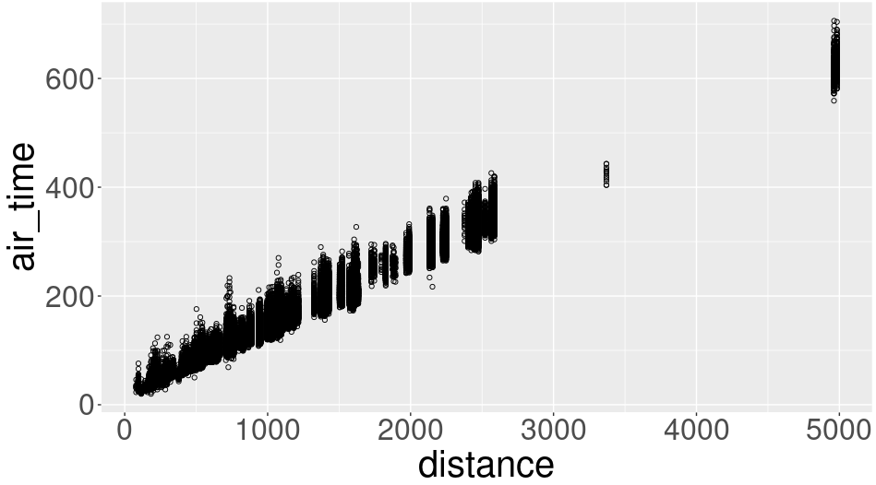
How to compute histogram of distances?
or mean for each distance bin (0, 1000, 2000, etc)

Slide 79
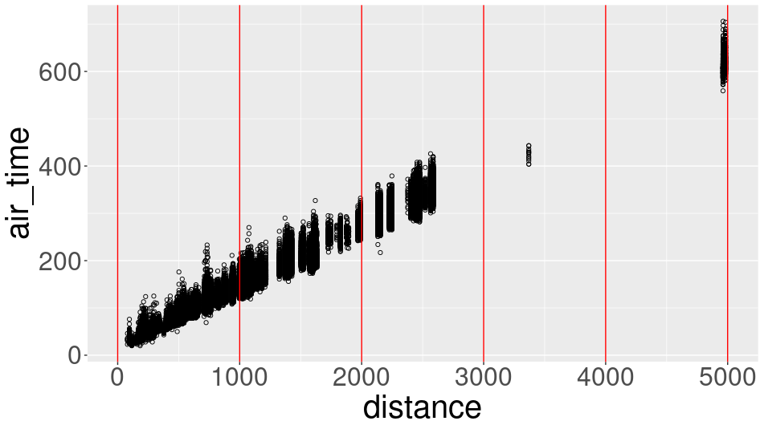
Define histogram bins
grid.point <- seq(0, 5000, by=1000)
grid.dt <- data.table(grid.point, distance=grid.point)

Slide 80
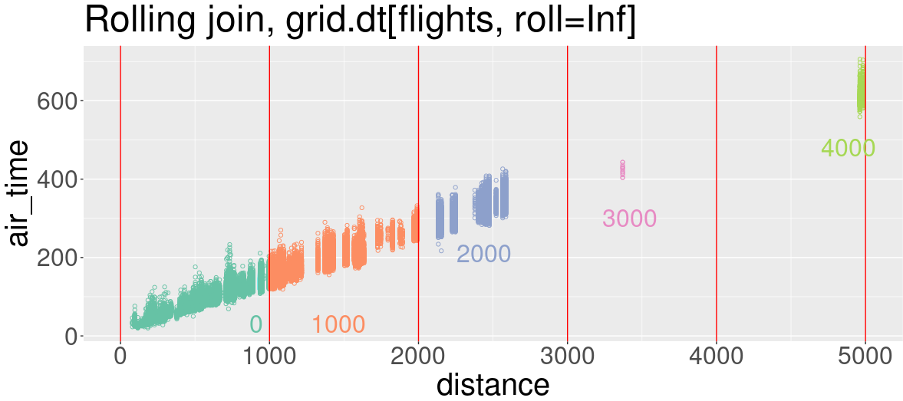
Rolling join, roll=Inf
each grid point matches the flights which occur after
> setkey(grid.dt, distance)
> setkey(flights, distance)
> (join.dt <- grid.dt[flights, roll=Inf])
grid.point distance year month day dep_delay arr_delay carrier origin dest air_time hour
1: 0 80 2014 1 30 9 17 US EWR PHL 46 15
2: 0 80 2014 1 30 -13 -25 US EWR PHL 34 17
---
253315: 4000 4983 2014 10 30 -6 1 HA JFK HNL 627 9
253316: 4000 4983 2014 10 31 -5 1 HA JFK HNL 633 9

Slide 81
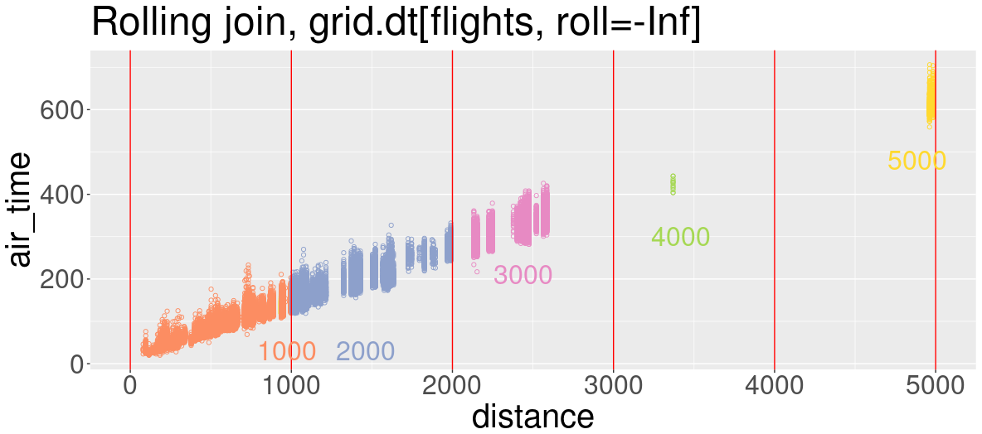
Rolling join, roll=-Inf
each grid point matches the flights which occur before
> setkey(grid.dt, distance)
> setkey(flights, distance)
> (join.dt <- grid.dt[flights, roll=-Inf])
grid.point distance year month day dep_delay arr_delay carrier origin dest air_time hour
1: 1000 80 2014 1 30 9 17 US EWR PHL 46 15
2: 1000 80 2014 1 30 -13 -25 US EWR PHL 34 17
---
253315: 5000 4983 2014 10 30 -6 1 HA JFK HNL 627 9
253316: 5000 4983 2014 10 31 -5 1 HA JFK HNL 633 9

Slide 82
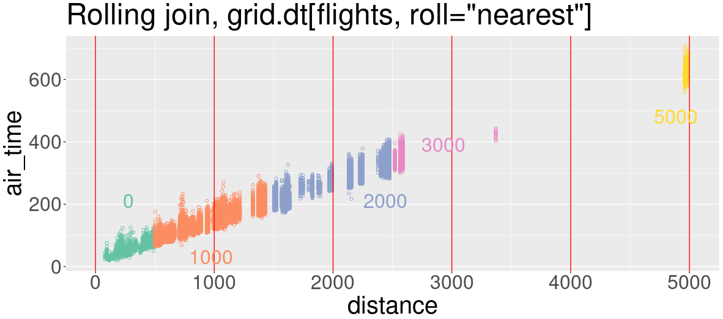
Rolling join, roll="nearest"
each grid point matches the flights which occur nearest
> setkey(grid.dt, distance)
> setkey(flights, distance)
> (join.dt <- grid.dt[flights, roll="nearest"])
grid.point distance year month day dep_delay arr_delay carrier origin dest air_time hour
1: 0 80 2014 1 30 9 17 US EWR PHL 46 15
2: 0 80 2014 1 30 -13 -25 US EWR PHL 34 17
---
253315: 5000 4983 2014 10 30 -6 1 HA JFK HNL 627 9
253316: 5000 4983 2014 10 31 -5 1 HA JFK HNL 633 9

Slide 83
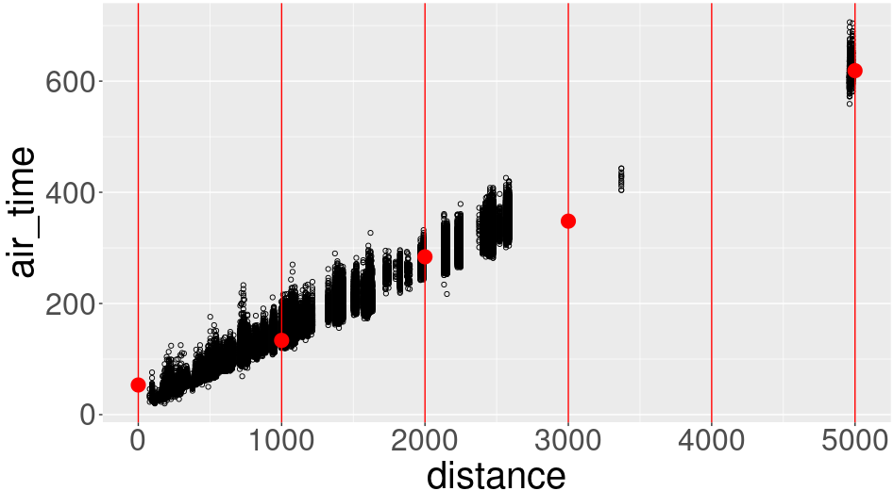
Summarize after rolling join
How to compute histogram/summary?
> join.dt[, .(num_flights=.N, mean_minutes=mean(air_time)), by=grid.point]
grid.point num_flights mean_minutes
1: 0 55212 53.33366
2: 1000 136285 133.56513
3: 2000 48593 283.92688
4: 3000 12665 348.11062
5: 5000 561 618.78253

Slide 84
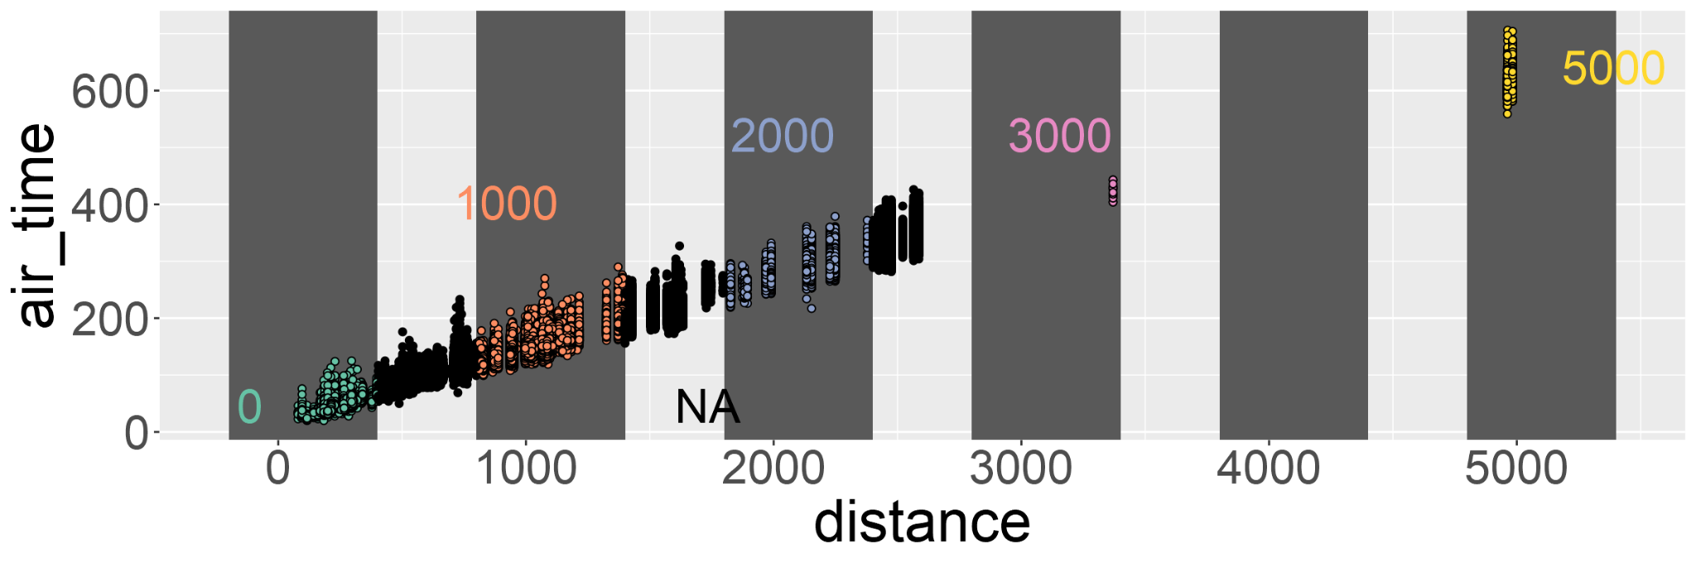
Non-equi join on=.(DTcol < icol)
> head(join.dt <- rect.dt[flights, .(
+ distance, air_time, grid.point
+ ), on=.(
+ min_dist<distance, max_dist>distance
+ )])
distance air_time grid.point
1: 2475 359 NA
2: 2475 363 NA
3: 2475 351 NA
4: 1035 157 1000
5: 2475 350 NA
6: 2454 339 NA
> (rect.dt <- data.table(
grid.point,
min_dist=grid.point-200,
max_dist=grid.point+400))
grid.point min_dist max_dist
1: 0 -200 400
2: 1000 800 1400
3: 2000 1800 2400
4: 3000 2800 3400
5: 4000 3800 4400
6: 5000 4800 5400
Join all rows which satisfy the given inequalities

Slide 85
Compute for every row in table i
think in terms of basic units — rows, columns and groups
data.table syntax provides placeholder for each of them
General form: DT[i, j, by=.EACHI]
Grouped by
what?
On which rows
What to do?

Slide 86
Summarize in join via by=.EACHI
> flights[three.days, .(
+ mean_air_time=mean(air_time),
+ num_flights=.N
+ ), by=.EACHI, on=.(month,day)]
month day mean_air_time num_flights
1: 3 17 168.9890 911
2: 9 26 151.4147 815
3: 12 25 NA 0
DT[ i, j, by=.EACHI, on] means, for each row in i, lookup the rows in DT which match using on columns, and compute/return j
Not the same as by=.(month,day) which would do the computation for every unique combination of month and day (much less efficient if we only want the result for a few combinations)

Slide 87
Data reshaping: wide to long (melt)
melt( )
Wide data
Few rows
Many columns
Long data
Many rows
Few columns
dcast( )
similar to stats::reshape(direction="long"), tidyr::pivot_longer( )

Slide 88
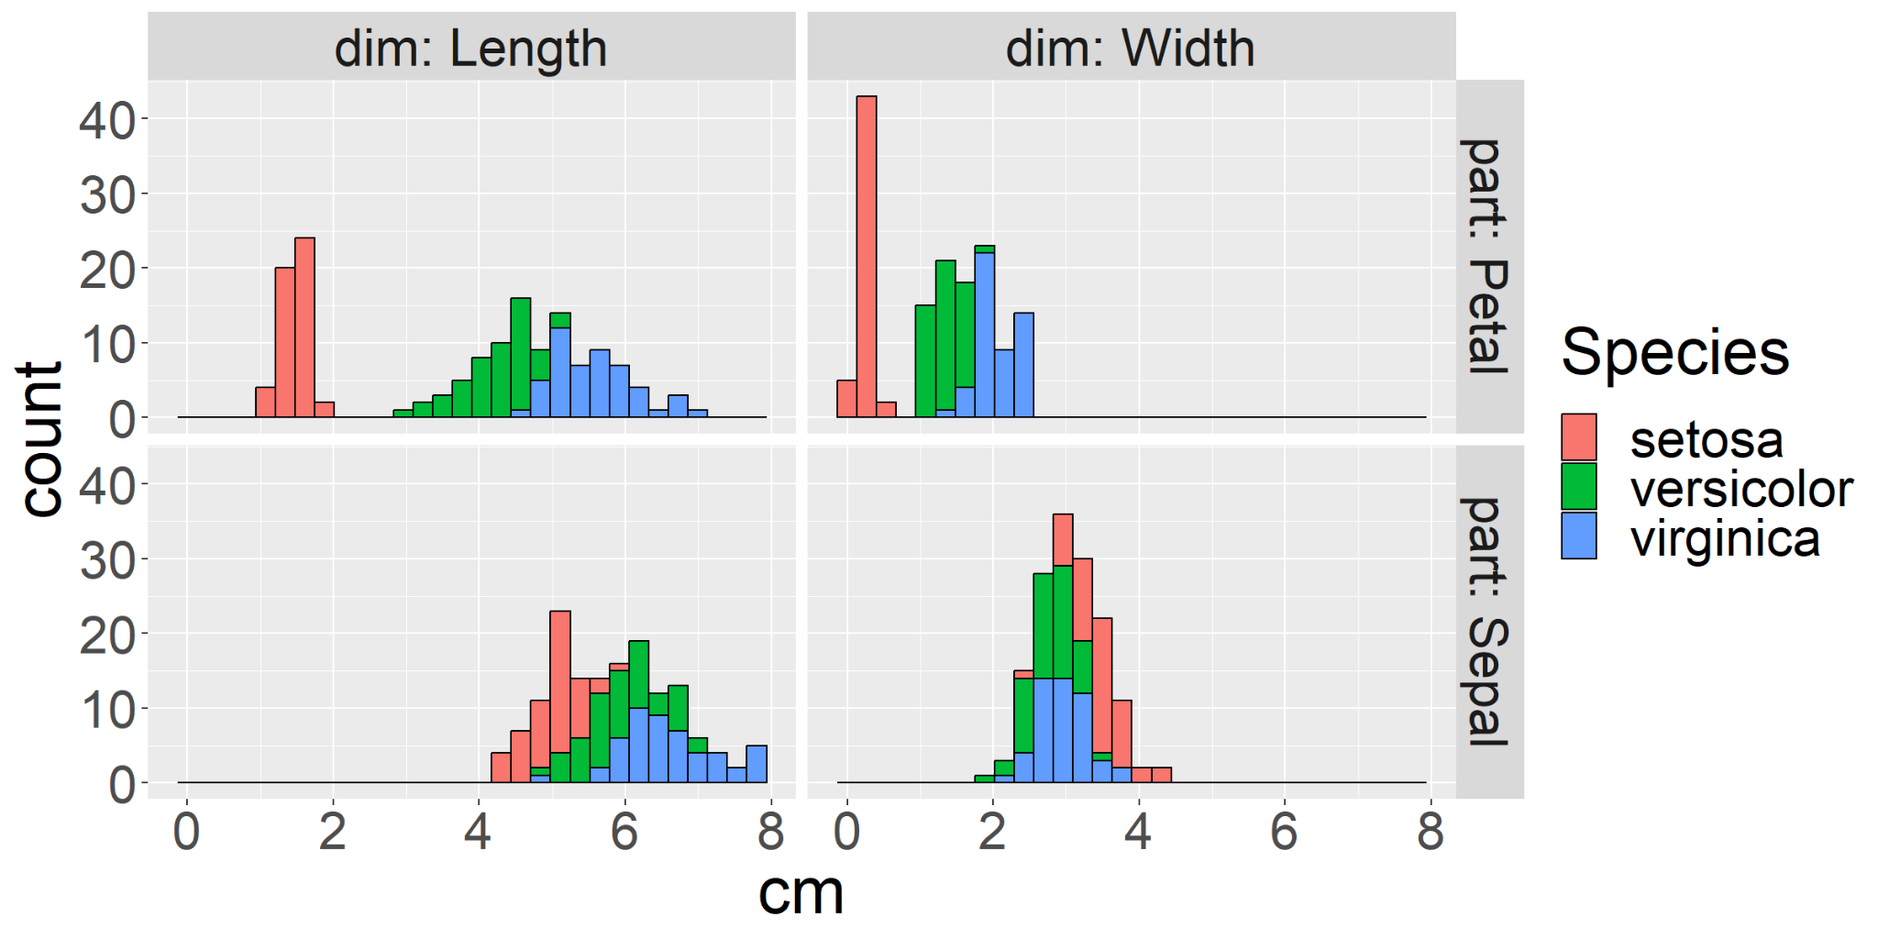
melt: wide to long data reshape
how to make the plot below of iris data?
iris has columns Sepal.Length, Sepal.Width, Petal.Length, Petal.Width, Species
would need facet_grid(part ~ dim) + geom_histogram(aes(cm, fill=Species)),
where dim column has values Length or Width, part values are Petal or Sepal
melt examples adapted from:
Hocking TD. Wide-to-tall data reshaping using regular expressions and the nc package. R Journal (2021), doi:10.32614/RJ-2021-029

Slide 89
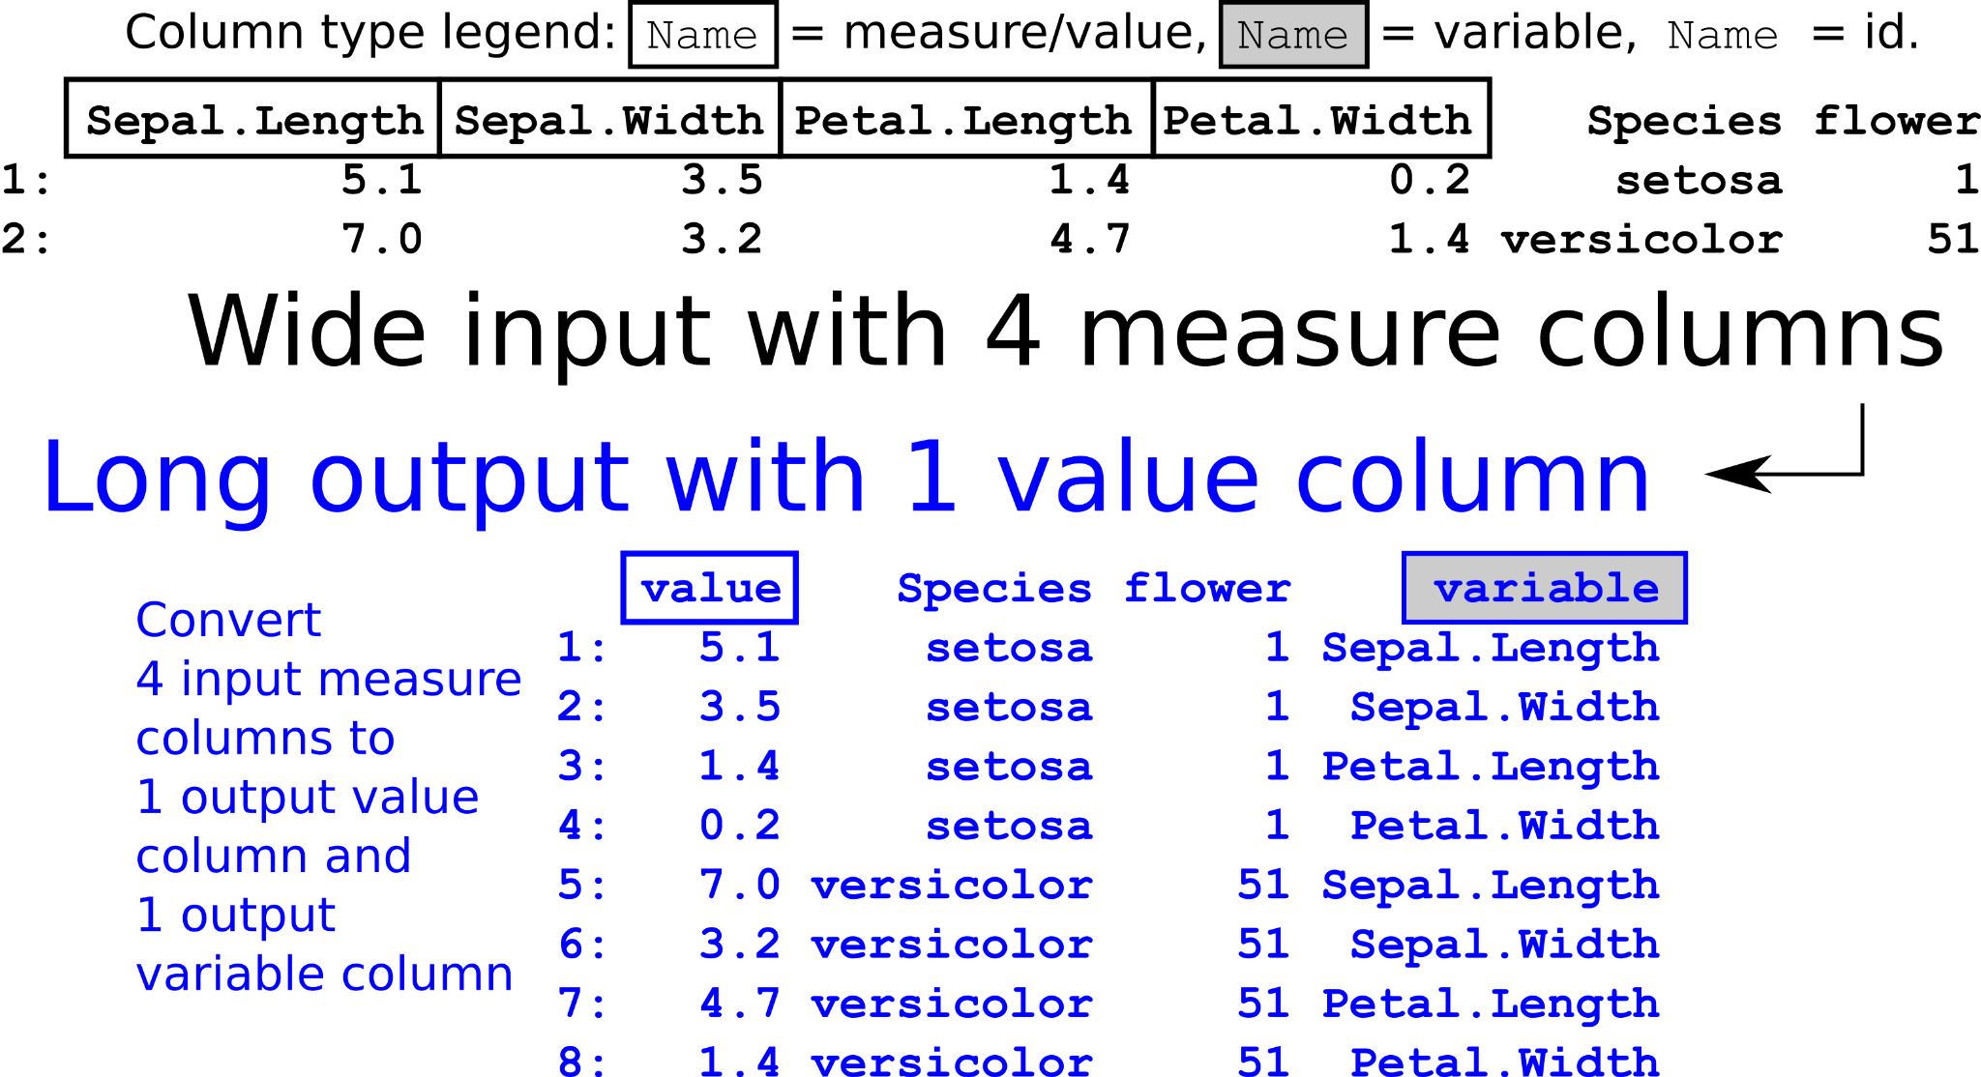
melt: wide to long data reshape
melt(DT, id.vars=c("Species","flower"))
figure source code
melt examples adapted from:
Hocking TD. Wide-to-tall data reshaping using regular expressions and the nc package. R Journal (2021), doi:10.32614/RJ-2021-029

Slide 90
melt: wide to long data reshape
melt(DT, measure.vars=c("Sepal.Length","Sepal.Width","Petal.Length","Petal.Width"))
figure source code
melt examples adapted from:
Hocking TD. Wide-to-tall data reshaping using regular expressions and the nc package. R Journal (2021), doi:10.32614/RJ-2021-029

Slide 91
melt: wide to long data reshape
melt(DT, measure.vars=patterns(".*[.].*"))
figure source code
melt examples adapted from:
Hocking TD. Wide-to-tall data reshaping using regular expressions and the nc package. R Journal (2021), doi:10.32614/RJ-2021-029

Slide 92
melt: wide to long data reshape
melt(DT, id.vars=c("ID1","ID2"))
melt(DT, measure.vars=c("valueA","valueB"))
melt(DT, measure.vars=patterns("regular expression"))
Exercise: melt the arr_delay and dep_delay columns of flights data, by specifying them as measure.vars
Additionally specify id.vars to limit which columns are copied to output
figure source code
melt examples adapted from:
Hocking TD. Wide-to-tall data reshaping using regular expressions and the nc package. R Journal (2021), doi:10.32614/RJ-2021-029

Slide 93
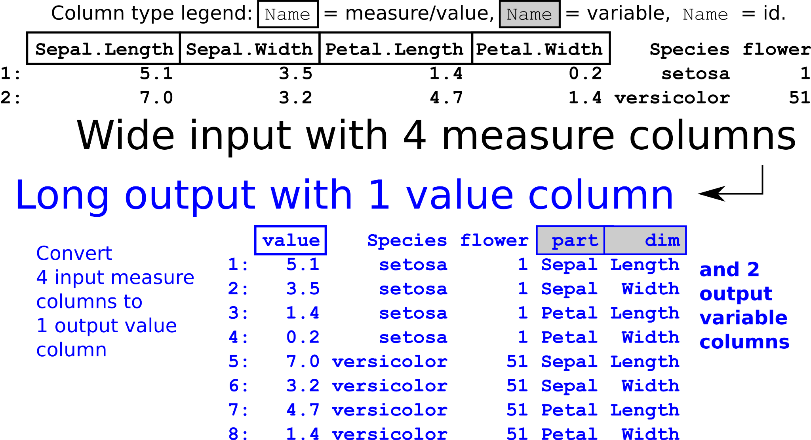
melt with measure( ), new on GitHub
melt(DT, measure.vars=measure(part,dim,pattern="(.*)[.](.*)"))
Capture groups ( ) in pattern used to define output variable columns
figure source code
melt examples adapted from:
Hocking TD. Wide-to-tall data reshaping using regular expressions and the nc package. R Journal (2021), doi:10.32614/RJ-2021-029

Slide 94
melt with measure( ), new on GitHub
melt(DT, measure.vars=measure(part,dim,sep=".")
Uses input columns with most groups after splitting (2 in this case)
figure source code
melt examples adapted from:
Hocking TD. Wide-to-tall data reshaping using regular expressions and the nc package. R Journal (2021), doi:10.32614/RJ-2021-029

Slide 95
melt with measure( ), new on GitHub
Exercise: make the plot below of iris data
First convert iris to data.table, then reshape using melt(DT, measure=measure(____________), value.name="cm")
library(ggplot2); ggplot( ) + facet_grid(part ~ dim) + geom_histogram(aes(cm, fill=Species), data=output_of_melt)
figure source code
melt examples adapted from:
Hocking TD. Wide-to-tall data reshaping using regular expressions and the nc package. R Journal (2021), doi:10.32614/RJ-2021-029

Slide 96
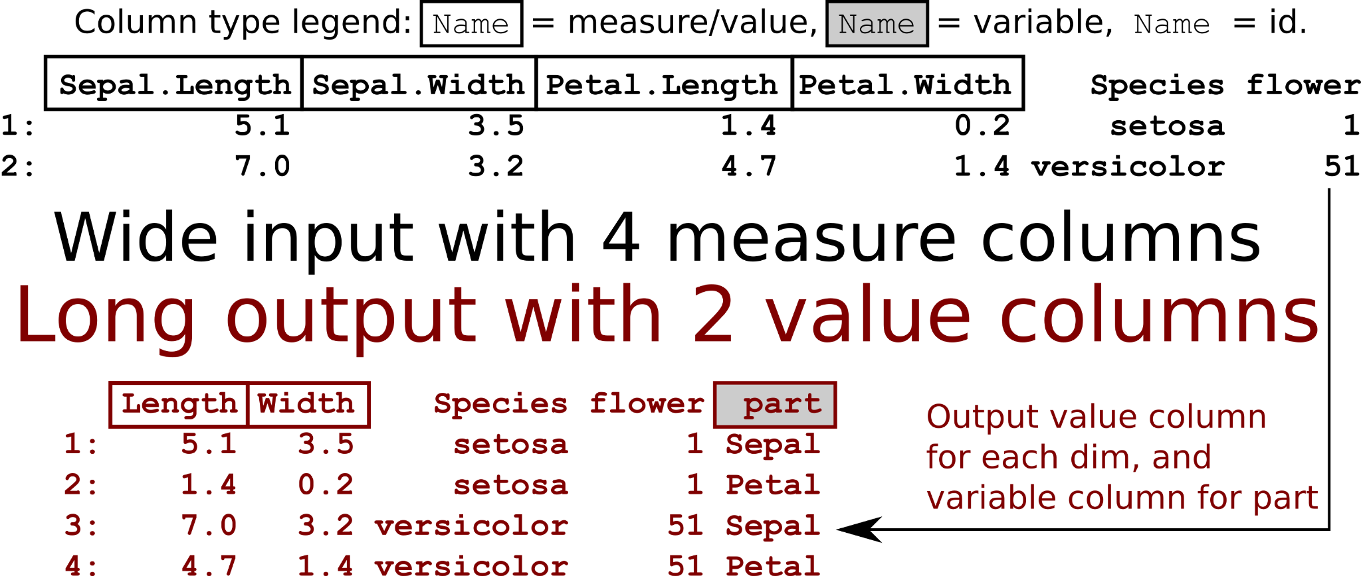
melt with measure( ), new on GitHub
melt(DT, measure.vars=measure(part, value.name, sep="."))
figure source code
melt examples adapted from:
Hocking TD. Wide-to-tall data reshaping using regular expressions and the nc package. R Journal (2021), doi:10.32614/RJ-2021-029

Slide 97
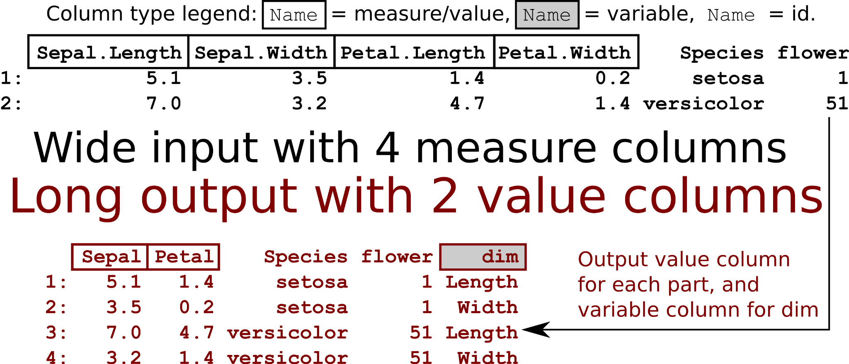
melt with measure( ), new on GitHub
melt(DT, measure.vars=measure(value.name, dim, sep="."))
figure source code
melt examples adapted from:
Hocking TD. Wide-to-tall data reshaping using regular expressions and the nc package. R Journal (2021), doi:10.32614/RJ-2021-029

Slide 98
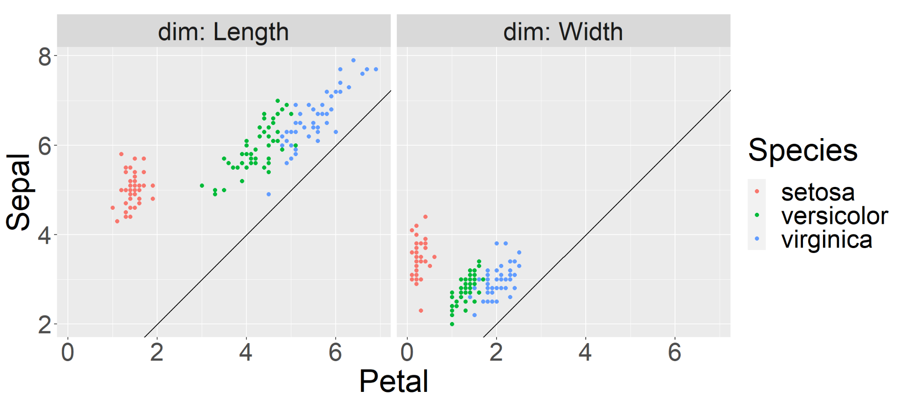
melt with measure( ), new on GitHub
Exercise: to show that sepals are larger than petals, make the plot below of iris data. First convert iris to data.table.
Then use melt with measure( ) to reshape
library(ggplot2); ggplot ( ) + facet_grid(. ~ dim) + geom_point(aes( Petal, Sepal, color=Species), data=output_of_melt)+ geom_abline( slope=1, intercept=0)
figure source code
melt examples adapted from:
Hocking TD. Wide-to-tall data reshaping using regular expressions and the nc package. R Journal (2021), doi:10.32614/RJ-2021-029

Slide 99
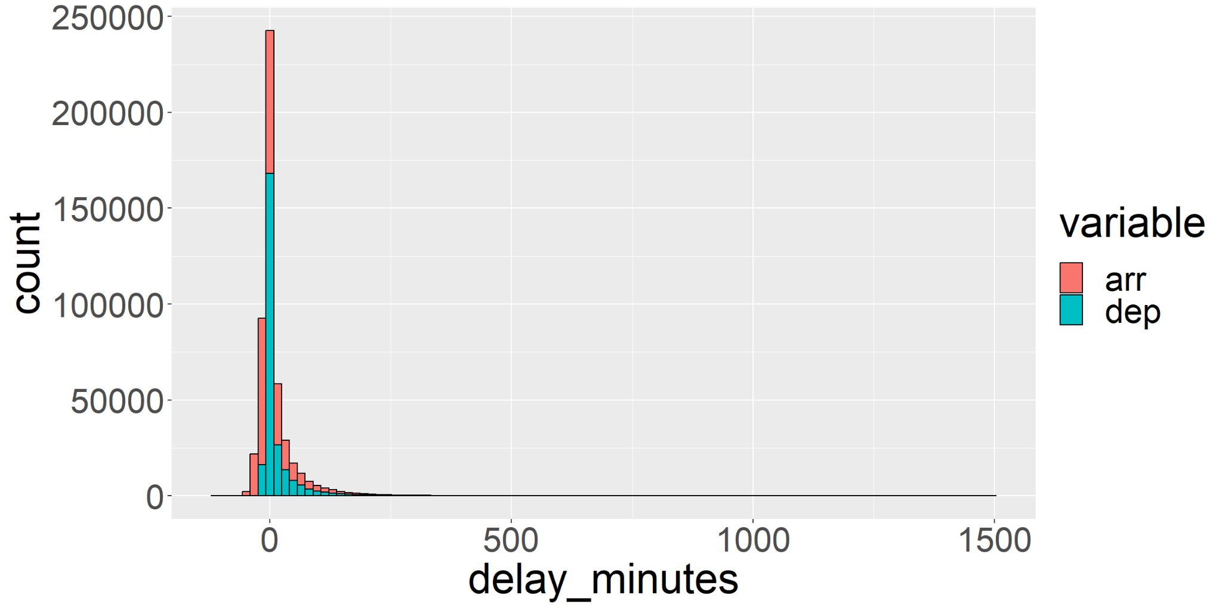
melt exercise for flights data
Exercise: make the plot below of flights data
Use melt with either patterns( ) or measure( ) to reshape
ggplot( ) + geom_histogram(aes(delay_minutes, fill=variable), data=output_of_melt)

Slide 100
Data reshaping: long to wide (dcast)
melt( )
Wide data
Few rows
Many columns
Long data
Many rows
Few columns
dcast( )
similar to stats::reshape(direction="wide"), tidyr::pivot_wider( )

Slide 101
dcast: long to wide reshape
dcast can get the original wide iris data back from the long version
> iris.dt=data.table(iris)[, flower := .I] # .I means row number in data.table
> iris.long=melt(iris.dt,measure=measure(part,dim,sep="."))
> head(iris.long)
Species flower part dim value
1: setosa 1 Sepal Length 5.1
2: setosa 2 Sepal Length 4.9
3: setosa 3 Sepal Length 4.7
4: setosa 4 Sepal Length 4.6
5: setosa 5 Sepal Length 5.0
6: setosa 6 Sepal Length 5.4
# Formula indicates where to put different values of variables: rows ~ cols
> iris.wide=dcast(iris.long, flower ~ part + dim, sep=".")
> head(iris.wide)
flower Petal.Length Petal.Width Sepal.Length Sepal.Width
1: 1 1.4 0.2 5.1 3.5
2: 2 1.4 0.2 4.9 3.0
3: 3 1.3 0.2 4.7 3.2
4: 4 1.5 0.2 4.6 3.1
5: 5 1.4 0.2 5.0 3.6
6: 6 1.7 0.4 5.4 3.9

Slide 102
dcast: long to wide reshape
dcast can compute a summary/aggregation function
> iris.long=melt(iris.dt,measure=measure(part,dim,sep="."),value.name="cm")
> iris.long
Species flower part dim value
1: setosa 1 Sepal Length 5.1
2: setosa 2 Sepal Length 4.9
3: setosa 3 Sepal Length 4.7
4: setosa 4 Sepal Length 4.6
5: setosa 5 Sepal Length 5.0
---
596: virginica 146 Petal Width 2.3
597: virginica 147 Petal Width 1.9
598: virginica 148 Petal Width 2.0
599: virginica 149 Petal Width 2.3
600: virginica 150 Petal Width 1.8
> dcast(iris.long, Species ~ dim, fun.aggregate=mean, value.var="cm")
Species Length Width
1: setosa 3.234 1.837
2: versicolor 5.098 2.048
3: virginica 6.070 2.500

Slide 103
dcast: long to wide reshape
dcast can compute several summary/aggregation functions
> iris.long=melt(iris.dt,measure=measure(part,dim,sep="."),value.name="cm")
> iris.long
Species flower part dim value
1: setosa 1 Sepal Length 5.1
2: setosa 2 Sepal Length 4.9
3: setosa 3 Sepal Length 4.7
4: setosa 4 Sepal Length 4.6
5: setosa 5 Sepal Length 5.0
---
596: virginica 146 Petal Width 2.3
597: virginica 147 Petal Width 1.9
598: virginica 148 Petal Width 2.0
599: virginica 149 Petal Width 2.3
600: virginica 150 Petal Width 1.8
> dcast(iris.long, Species ~ dim, fun.aggregate=list(min, mean, max), value.var="cm")
Species cm_min_Length cm_min_Width cm_mean_Length cm_mean_Width cm_max_Length cm_max_Width
1: setosa 1.0 0.1 3.234 1.837 5.8 4.4
2: versicolor 3.0 1.0 5.098 2.048 7.0 3.4
3: virginica 4.5 1.4 6.070 2.500 7.9 3.8

Slide 104
dcast: long to wide reshape
dcast can compute for several value columns
> iris.long=melt(iris.dt,measure=measure(part,value.name,sep="."))
> iris.long
Species flower part Length Width
1: setosa 1 Sepal 5.1 3.5
2: setosa 2 Sepal 4.9 3.0
3: setosa 3 Sepal 4.7 3.2
4: setosa 4 Sepal 4.6 3.1
5: setosa 5 Sepal 5.0 3.6
---
296: virginica 146 Petal 5.2 2.3
297: virginica 147 Petal 5.0 1.9
298: virginica 148 Petal 5.2 2.0
299: virginica 149 Petal 5.4 2.3
300: virginica 150 Petal 5.1 1.8
> dcast(iris.long, Species ~ part, fun.aggregate=mean, value.var=c("Length","Width"))
Species Length_Petal Length_Sepal Width_Petal Width_Sepal
1: setosa 1.462 5.006 0.246 3.428
2: versicolor 4.260 5.936 1.326 2.770
3: virginica 5.552 6.588 2.026 2.974

Slide 105
dcast: long to wide reshape
dcast can compute several functions for several value columns
> iris.long=melt(iris.dt,measure=measure(part,value.name,sep="."))
> iris.long
Species flower part Length Width
1: setosa 1 Sepal 5.1 3.5
2: setosa 2 Sepal 4.9 3.0
3: setosa 3 Sepal 4.7 3.2
4: setosa 4 Sepal 4.6 3.1
5: setosa 5 Sepal 5.0 3.6
---
296: virginica 146 Petal 5.2 2.3
297: virginica 147 Petal 5.0 1.9
298: virginica 148 Petal 5.2 2.0
299: virginica 149 Petal 5.4 2.3
300: virginica 150 Petal 5.1 1.8
~ . means no reshaping variables in columns
> dcast(iris.long, Species + part ~ ., fun.aggregate=list(min, max), value.var=c("Length","Width"))
Species part Length_min Width_min Length_max Width_max
1: setosa Petal 1.0 0.1 1.9 0.6
2: setosa Sepal 4.3 2.3 5.8 4.4
3: versicolor Petal 3.0 1.0 5.1 1.8
4: versicolor Sepal 4.9 2.0 7.0 3.4
5: virginica Petal 4.5 1.4 6.9 2.5
6: virginica Sepal 4.9 2.2 7.9 3.8

Slide 106
Exercise
dest EWR JFK LGA
1: ABQ 0 278 0
2: ACK 0 277 0
3: AGS 0 0 3
4: ALB 169 0 0
5: ANC 13 0 0
...
Make a table as above, with one column for every origin, and one row for every destination (entries are flight counts). Hint: use dest ~ origin to create a different dest on each row, and a different origin on each column.
Specify value.var=c("arr_delay","dep_delay") with fun.aggregate=mean to compare the average delays. Use this info to pick the best airport for any given destination.

Slide 107
import data.table in your package
data.table is already imported by 1400+ CRAN packages
"Imports: data.table" in DESCRIPTION
"import(data.table)" in NAMESPACE
. <- j_variable <- NULL in first line of R function to avoid CRAN NOTE about no visible function/variable
data.table::setDTthreads(2) in examples/tests to avoid CRAN NOTE about taking too much time (data.table uses 1/2 of all CPUs by default)

Slide 108
Avoiding CRAN NOTE 1
. <- j_variable <- NULL in first line of R function to avoid CRAN NOTE about no visible function/variable
my_fun <- function(DT) DT[, .(m=mean(x)), by=y]
* checking R code for possible problems ... NOTE
my_fun: no visible global function definition for ‘.’
my_fun: no visible binding for global variable ‘x’
my_fun: no visible binding for global variable ‘y’
...
Undefined global functions or variables:
. x y
To avoid CRAN check NOTE as above, use R code like below:
my_fun <- function(DT){
x <- y <- . <- NULL
DT[, .(m=mean(x)), by=y]
}

Slide 109
Avoiding CRAN NOTE 2
CRAN requires packages to use max 2 CPUs during checks
data.table default uses 1/2 of all CPUs on machine
Flavor: r-devel-linux-x86_64-debian-gcc
Check: examples, Result: NOTE
Examples with CPU time > 2.5 times elapsed time
user system elapsed ratio
aum_line_search 12.349 0.322 1.935 6.548
aum_line_search_grid 10.033 0.308 1.781 5.806
aum_diffs_penalty 4.730 0.169 1.635 2.996
To avoid CRAN check NOTE as above, use R code like below in examples and tests:
data.table::setDTthreads(2)

Slide 110
4/4
Contributing to data.table

Slide 111

Community blog and survey
data.table mascot is a sea lion, which barks "R R R"
data.table community has a new blog, The Raft, https://rdatatable-community.github.io/The-Raft/ sea lions often float together on the ocean's surface in groups called "rafts." - Marine Mammal Center
Please fill out our community survey, https://tinyurl.com/datatable-survey
~10 minutes, tell us how you use data.table!
(help us choose what to prioritize in the future)

Slide 112
GitHub repository
data.table has an active issue/Pull Request(PR) tracker https://github.com/Rdatatable/data.table/
1000+ open issues, 100+ open PRs
if you have any time/interest, we could use your help!
easy first contribution: try reproducing an issue (very helpful to know if an issue is reproducible)
very inclusive community -- after you submit your first PR, you will be invited to join the github group!
now is a very exciting time to get involved, as we are currently creating a formal written document describing de-centralized project governance, issue #5676

Slide 113
Translation Awards
In 2023-2025, National Science Foundation has provided funds to support expanding the ecosystem of users and contributors around data.table
20 translation awards, US$500 each, in order to make documentation and messages more accessible, ideas:
Translate errors/warnings/messages (potools package can help)
Translate most important vignettes (intro, import, reshape)
Translate other documentation (cheat sheets, slides, etc)
Priority: Portuguese, Spanish, Chinese, French, Russian, Arabic, Hindi
Call for proposals: https://rdatatable-community.github.io/The-Raft/

Slide 114
Travel awards
In 2023-2025, National Science Foundation has provided funds to support expanding the ecosystem of users and contributors around data.table
Eight travel awards, US$2700 each
Candidates should give a talk about data.table at a conference with a relevant audience (potential data.table users or contributors)
Call for proposals coming soon on https://rdatatable-community.github.io/The-Raft/

Slide 115
Summary of data.table
concise, consistent syntax
fast, memory efficient
No dependencies (easy to install)
No breaking changes (easy to upgrade)
Inclusive user/developer community with opportunities to contribute:
translation awards, US$500 each
travel awards, US$2700 each

Slide 116
Thank you! Questions?
Toby Dylan Hocking
Assistant Professor
Northern Arizona University
toby.hocking@r-project.org
Please use/adapt these slides as you like,
as long as you give me some credit,
as I have done for Arun below.
Funded by NSF POSE program, project #2303612.
Slides adapted from Arun Srinivasan, and datatable-intro vignette - thanks!

